Slide 1
Connected System Recovery (CSR) New Software & Support Training Learning Material
CSWi23F| v110624

Slide 2
Course Topics
Learning Material
Topic 1: Introduction
Topic 2: Usage Steps
Topic 3: Troubleshooting
Topic 4: Links and Resources

Slide 3
Introduction
Topic 1

Slide 4
What is Connected System Recovery (CSR)?
Connected System Recovery is a Windows recovery feature that you can use when your issue is so severe that the device won’t boot up and you want to completely wipe and reset the device to a factory-like state. (This is not the same as the Lenovo Recovery service, click here to learn about the differences)
This feature is complementary to existing Windows recovery features, and we recommend you try using push-button reset first so you can preserve your data and device personalization. If that fails, Connected System Recovery will fully reset your device and download a fresh copy of Windows and certain customizations that your device was initially manufactured with.
Caution: During Connected System Recovery, all local files and personal data will be wiped from the device, and it will not be possible to recover. Please proceed with caution.

Slide 5
The difference between Microsoft CSR and Lenovo Recovery
Feature | Microsoft CSR | Lenovo Recovery Media
OS Version | Last online version | Fixed preload version
Drivers | All latest version drivers | All fixed preload version drivers
Apps | Only UWP (Microsoft Store) | All apps
You can learn more from below materials.
How to use Connected System Recovery (Cloud Bare Metal Recovery) - ThinkPad - Lenovo Support IT
Lenovo Learning Lenovo Recovery Service (CWSi238)

Slide 6
When should I use Connected System Recovery?
Since it will remove all your apps, device personalizations, and personal data from your device, Connected System Recovery should only be used as a recovery tool of last resort when your device will not boot up and you need a working PC quickly.
In addition, it can also be used if you would like to completely reset your device to a factory-like state for any reason (recycling, donation, ownership change, etc.) and you do not require any of the local data saved on the device.
It should not be used if you have important local data saved on the device that you would like to preserve. We don’t recommend this feature if your PC is running slow.

Slide 7
What will my device look like after using CSR?
After performing the Connected System Recovery, your device will be reset to a factory-like state as if you have received the device for the first time. Connected System Recovery removes all personal data on your device and recovers the previously unbootable system to a fresh copy of the last known version of Windows you had on your device.
You will need to go through the standard setup experience to set up your device. The device will have only UWP apps (from the Microsoft Store), language packs, and optional features. The latest required hardware drivers will be downloaded during the Connected System Recovery.
Preloaded apps which can be downloaded from Microsoft Store app, such as Vantage will be downloaded during the Connected System Recovery.
Win32 desktop apps would need to be manually reinstalled (from the Lenovo Support website) after the device is up and running.

Slide 8
What is Connected System Recovery doing to my device?
Connected System Recovery will contact Microsoft’s servers to download the Windows Recovery Environment.
This Windows Recovery Environment will then use the information stored in your BIOS by Lenovo to download and rebuild Windows entirely on your device, which involves wiping the device storage and repartitioning it as Lenovo built it.
After downloading and installing Windows and its accompanying features, the device will reboot into the new device experience to allow the user to set up the device as if it were brand new.

Slide 9
Usage Steps
Topic 2

Slide 10
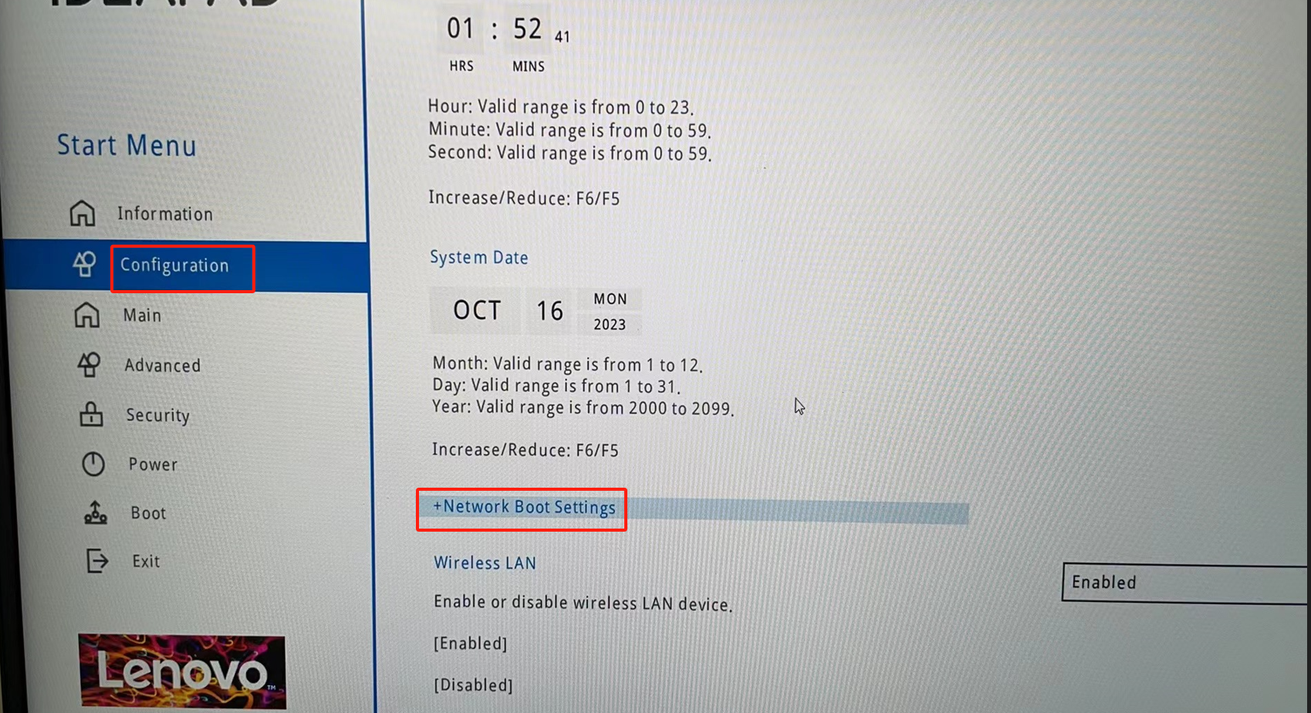
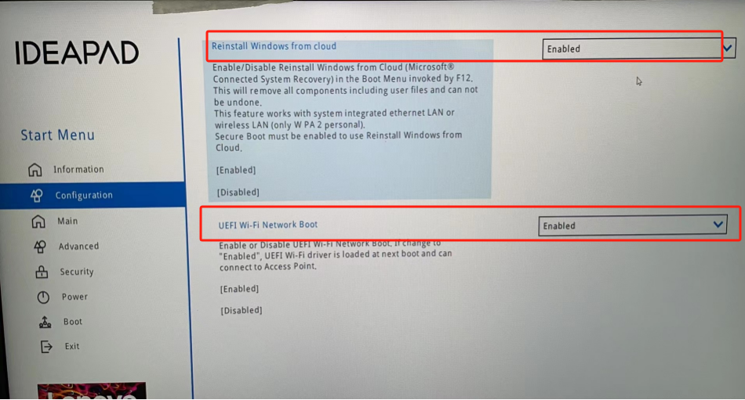
Connected System Recovery Usage - 1
Power on your PC, and then press F2 immediately to enter BIOS Setup Menu.
In the Configuration menu click on Network Boot Settings and enable "Reinstall Windows from cloud" and "UEFI Wi-Fi Network boot ".

Slide 11
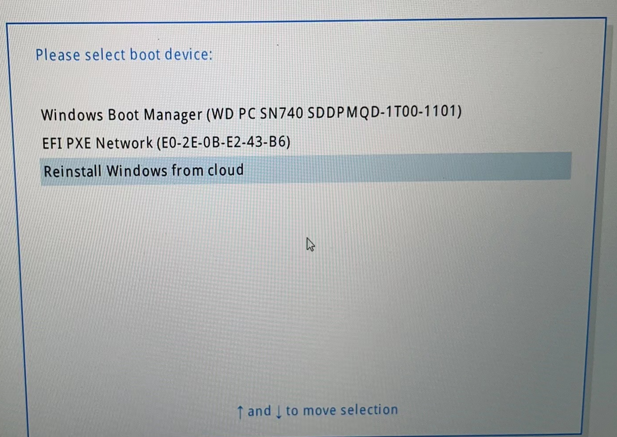
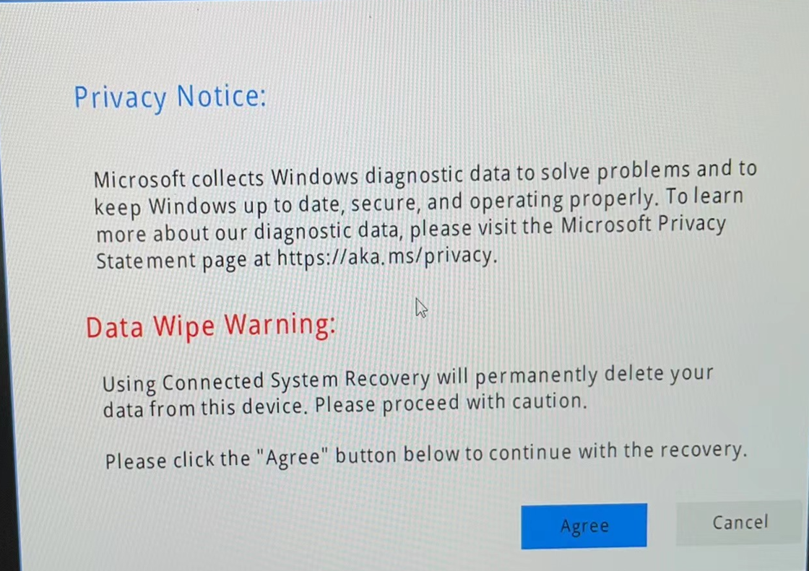
Connected System Recovery Usage - 2
Press F10 to save changes and reboot your system and then press F12 immediately to enter Boot Menu.
Choose “Reinstall Windows from cloud”.
Choose “Agree” and wait for Windows to complete the installation from the cloud.

Slide 12
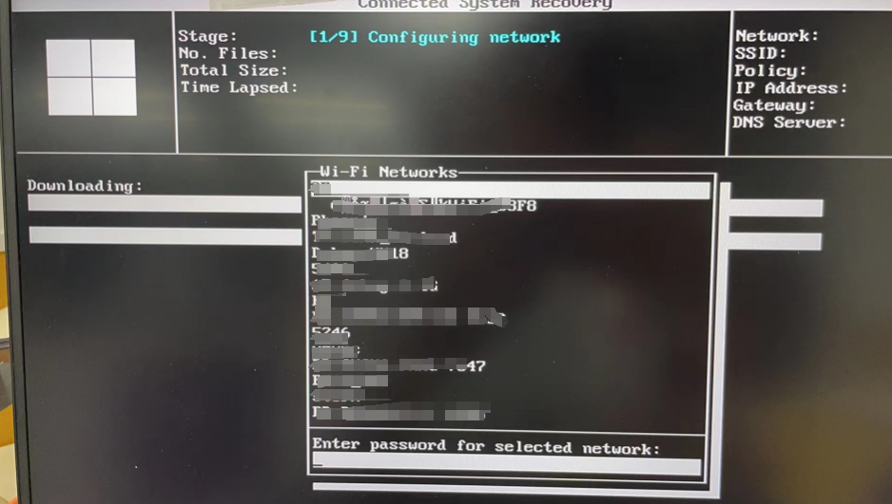
Connected System Recovery Usage - 3
Connect to the Internet through Wi-Fi or LAN and expect 1-2 hours for the process to complete.
Consumer & DT devices: The Wi-Fi connection prompt is displayed while running CSR
ThinkPad: Connect to the network in the BIOS before running CSR

Slide 13
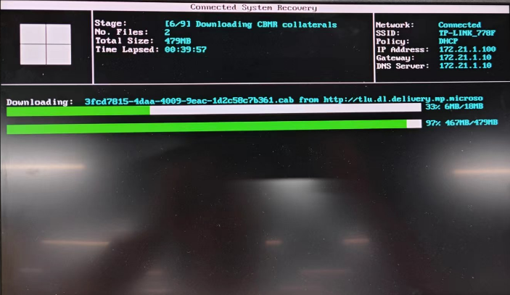
Downloading Process

Slide 14
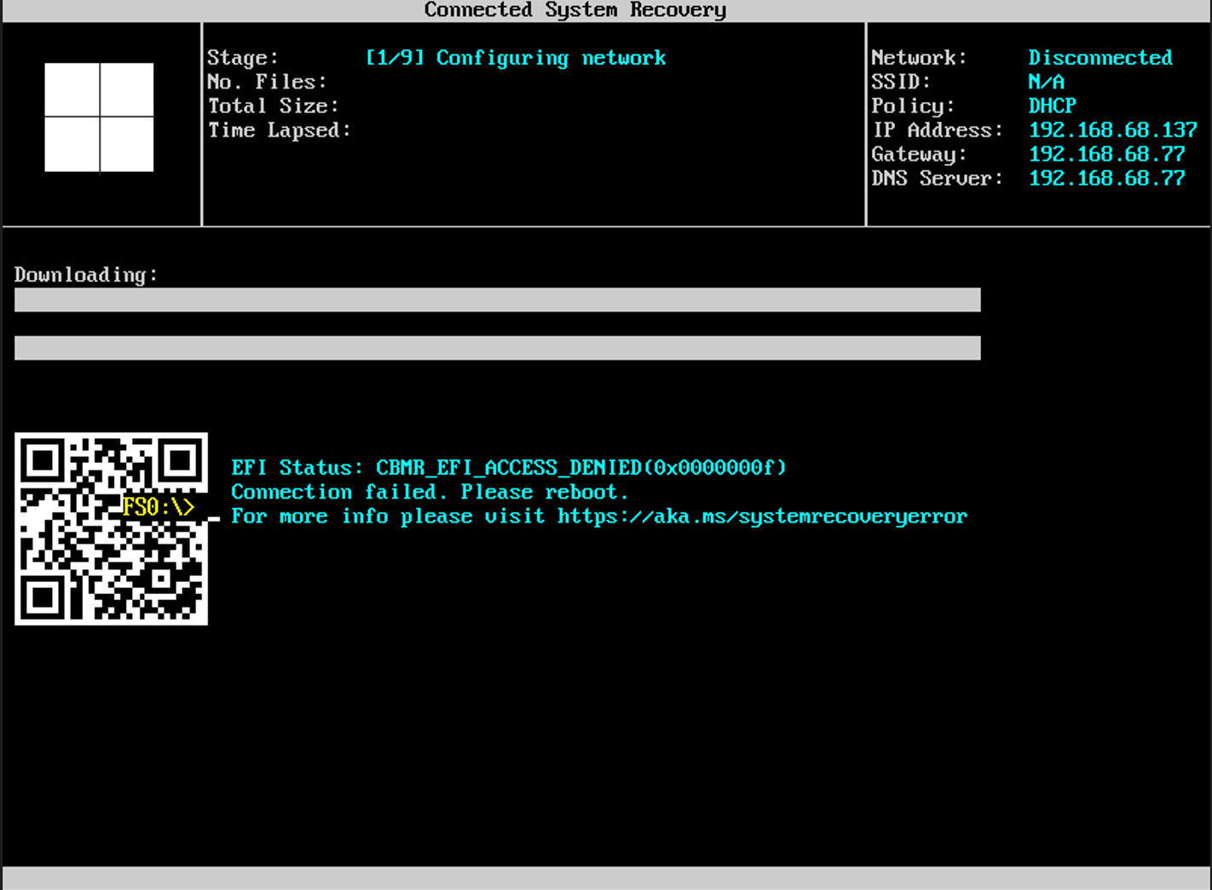
Failure Screenshot

Slide 15
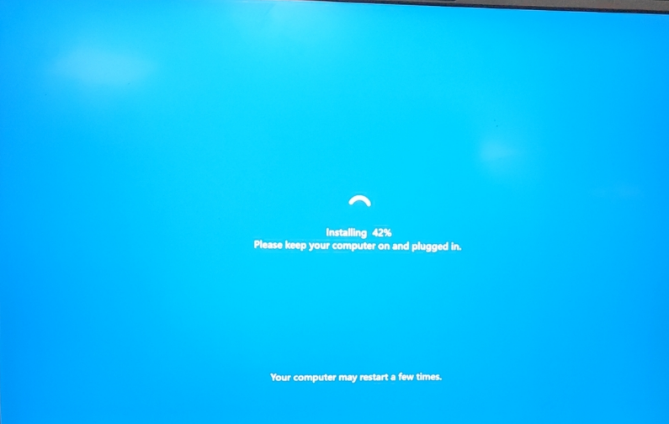
Installing Process

Slide 16
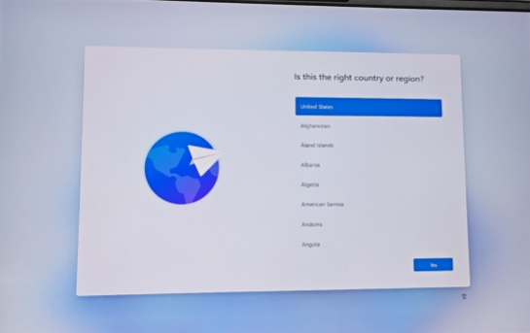
First Time Set Up

Slide 17
Troubleshooting
Topic 4

Slide 18
Troubleshooting Questions - 1
How do I know if my device supports Connected System Recovery?
Connected System Recovery is being rolled out on a per-device basis, you can check your device's BIOS and see if there is an option for Connected System Recovery. Currently not all the Lenovo devices support CSR.

Slide 19
Troubleshooting Questions - 2
2. If Connected System Recovery is failing for you, please check the following:
Is your device successfully connected to network: This should be checked after selecting the Connected System Recovery option in your BIOS menu.
Is your device connected to AC power: While it's not required if your device has sufficient battery power, it's possible this may lead to failure when initiating Connected System Recovery.
Is your router functioning properly: Try restarting your router and modem and then try Connected System Recovery again.
Restart your system: If none of the above suggestions fix the issue, try restarting your device by holding down the power button until your device fully shuts down, release it, wait a few seconds, and then turn it back on and try Connected System Recovery again.

Slide 20
Troubleshooting Questions - 3
No# | Question Asked | Answer Given
1 | Will there be any change in RUSB process as a result of CSR technology? | 1. RUSB's system is designed to install the system on a USB flash drive, while CSR is a built-in recovery tool that allows users to restore the Windows operating system on the device themselves in the event of a catastrophic operating system/device failure, without any external guarantee. 2. How to choose CSR or RUSB tool? - This depends on user requirements. The system restored through RUSB is the system we shipped with more drivers and software and maybe some fees. The system restored through CSR is the latest OS +basic drivers+ preloaded apps in Microsoft Store, and it is free. 3. Will RUSB remain? - RUSB will remain.
2 | Connected System Recovery is recovery for Lenovo image? or MS OEM one? | The latest OS (based on the same OS version of the device shipped) with basic drivers and preloaded apps which can be download from Microsoft Store, such as Vantage.
3 | Need to connect the Lan? or can connect the WIFI trough the CSR interface ? | Supports both Wi-Fi, LAN / RTK dongle. Lan networks will display Ethernet, and wireless networks will display the name of the WIFI network you are connected to. Recommended Lan network, more stable.
4 | Any reminder message that all data will be erased? | Yes, you should accept the Data Wipe Warning and click Agree before starting CSR.

Slide 21
Links and Resources
Topic 5

Slide 22
Links and Resources
About Connected System Recovery - Microsoft Support

Slide 23
CSR EFI Architecture
CSR is a Microsoft cloud bare metal recovery solution; it contains 2 components – EFI App & Cloud PBR. The newly introduced items are in EFI part and include
cBMR EFI driver - the major payload to recover the system
cBMR EFI App - for Wi-Fi connections and handling the credentials to EFI driver.
cBMR App
(UI)
BIOS
cMBR (cloud Bare Metal Recovery) app/drivers operate as a client/server architecture via the EFI protocol. They share a weak dependency and allow for customized solutions:
Lenovo can customize the UI with brand-specific features
Microsoft can add more features into the driver without the need to update the UI
Wi-Fi credential
cBMR Driver
Boot up networking
TLS
HTTP
Wi-Fi EFI driver
MS/OEM
MS
IBV
IHV

Slide 24
Assessment

Slide 25

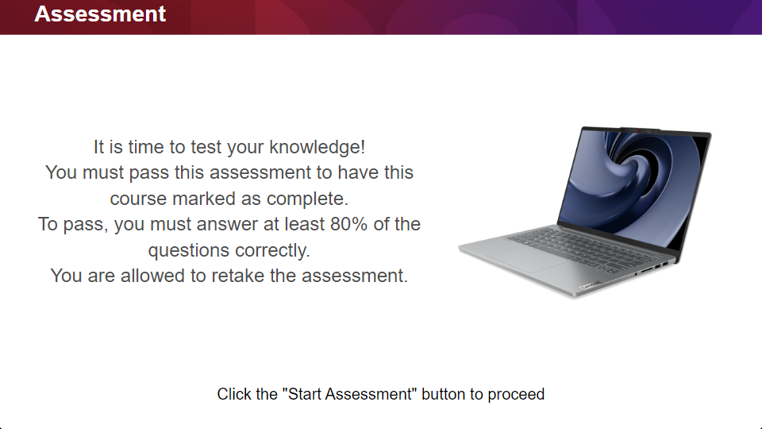
Quiz
Click the Quiz button to edit this object

Slide 26
Survey

Slide 27
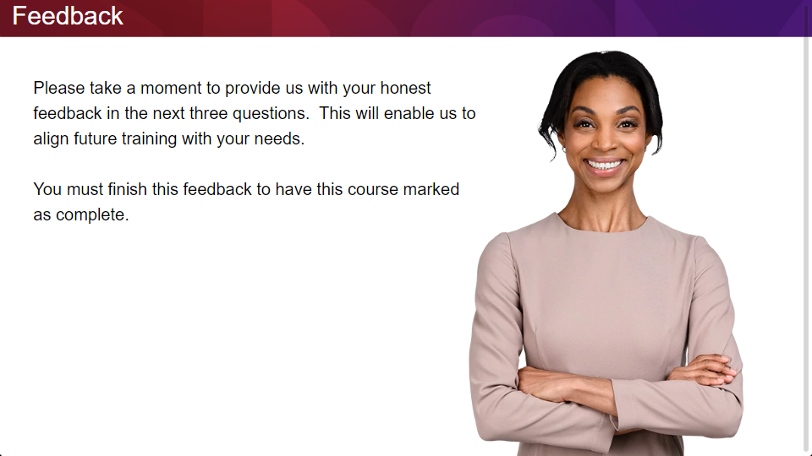
Quiz
Click the Quiz button to edit this object

